Slide 1
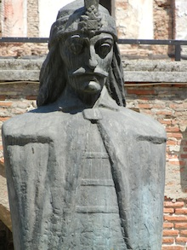
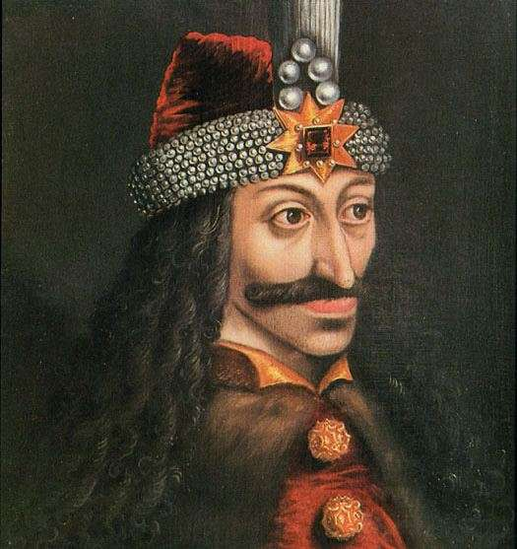
Vlad the impaler
By: Brianna Trumble

Slide 2
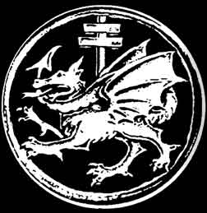
life
There is no record of when he was officially born but it was sometime in winter of 1431
Real name Vlad III Dracul
Educated
He was tribute with his brother Radu to the sultan
He had brothers
His father in life was a member of order of the dragons
He died at 45
Born in Wallachia
Had a wife Countess Ilona Szilagy
Had two children

Slide 3
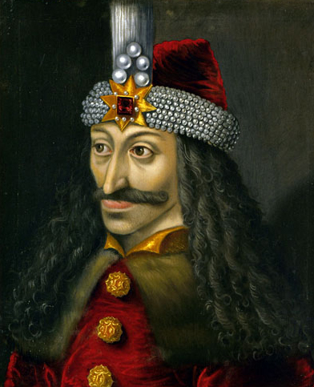
ruling
Ruled three times in his life
First rule was short
Impaled forest legend
He ruled with the thought of revenge
Everyone was equal in his kingdom
Third rule was short as well
Called voivode Vlad III to mean king vlad III
Ruled around a total of 7 years

Slide 4
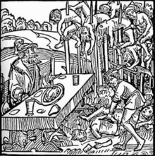
Interesting facts
Became impaler after death
Draco means dragon or devil
He created spike based on rank
Tortured for fun and, entertainment
He also dismembered, gouged, boiled alive,
Skinned alive, etc.
Dracula means son of dragon or son of devil
Wallachia is now a portion of the country of Romania
Said to have killed between 40,000 – 100,000 people in his rule

Slide 5
Human rights

Slide 6
Article 3 Everyone has the right to life, liberty and security of person.
He would do as he pleased
You could die at any moment
He would keep the died up on their stakes for days at a time

Slide 7
Article 4 No one shall be held in slavery or servitude; slavery and the slave trade shall be prohibited in all their forms.
He would enslave all who he wanted
If you could work you were a slave
He would make you a slave untiled you were finished or you died

Slide 8
Article 5 No one shall be subjected to torture or to cruel, inhuman or degrading treatment or punishment.
He would torture and degrade you
He thought of some people as less than animals
He would give you what he thought was fair

Slide 9
Article 9 No one shall be subjected to arbitrary arrest, detention or exile
He felt that you did something wrong he would arrest you
You would never be exiled because, he would either torture you or kill you
He could make you his new slave

Slide 10
Article 12 No one shall be subjected to arbitrary interference with his privacy, family, home or correspondence, nor to attacks upon his honour and reputation.
He would kill you if he felt like it
You had no trial because, he was judge and jury
You would be used as a reminder

Slide 11
Connecting quotes
1. but to safety thus. our fears in Banquo stick deep, and in his royalty of nature reigns that which would be fear’d: ‘tis much he dares, (III.I.49-51)
2. ourself will mingle with society and play the humble host. (III.IV.3-4)
3.then comes my fits again: I had else been perfect; (III.IV.21)
4. time, thou anticipat’st my dread exploits; the flighty purpose never is o’ertook unless the deed go with it; from this moment the very firstlings of my heart shall be the firstlings of my hand. (IV.I.144-148)

